Slide 1
Generative artificial intelligence and OER: a blessing or a big risk?
Informationsveranstaltung ORCA.nrw
12.12.2023
Robert Schuwer

Slide 3
Agenda
What are we talking about?
Potential advantages
Potential risks & ethical issues
Consequences
Some questions to discuss about

Slide 4
What are we talking about?

Slide 5
Open Educational resources
Open Educational Resources (OER) are
learning, teaching and research materials
in any format and medium
that reside in the public domain or are under copyright
that have been released under an open license that permit
no-cost access,
re-use, repurpose, adaptation and redistribution
by others
(UNESCO, 2019)

Slide 6
Open Educational Practices / Open Pedagogy
Open Educational Practices are defined as practices which support the (re)use and production of OER through institutional policies, promote innovative pedagogical models, and respect and empower learners as coproducers on their lifelong learning path
Open Pedagogy is a collection of characteristic activities related to working in open networks and the use of open educational resources where the student has a central role in assessing, creating and sharing information
(Andrade et al, 2011, p. 12) (Post et al, 2022, p. 4)

Slide 7
Generative Artificial Intelligence (Gen-AI)
Generative AI (Gen-AI) is
an Artificial Intelligence (AI) technology
that automatically generates content
in response to prompts
written in natural language conversational interfaces.
(Miao & Holmes, 2023)

Slide 8
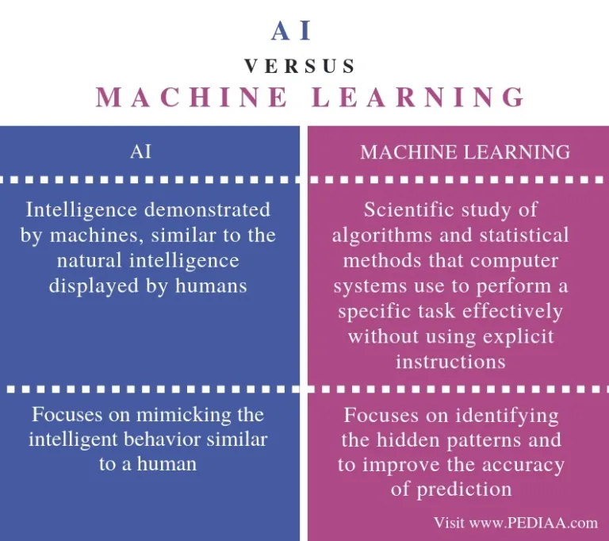
Symbolic AI vs machine Learning
E.g. Rule-based systems
(Expert systems)
E.g. Large Language Models
https://pediaa.com/what-is-the-difference-between-ai-and-machine-learning/

Slide 9
AI and education
(Molenaar, 2022)

Slide 10
Potential advantages

Slide 11
Potential of (Gen-)AI in OER and Open Educational Practices (OEP)
Automatic content generation
OER as set of prompts
Resource curation
Enhance findability of OER
Automatic metadata generation
Updating existing resources
Translation, localisation
Facilitating adaptive learning with OER
Learning analytics (partial automation)
Automated feedback (conditional automation)
Co-creation OER
Facilitating collaborative learning in OEP
(Bozkurt, 2023; Wiley, 2023)

Slide 12
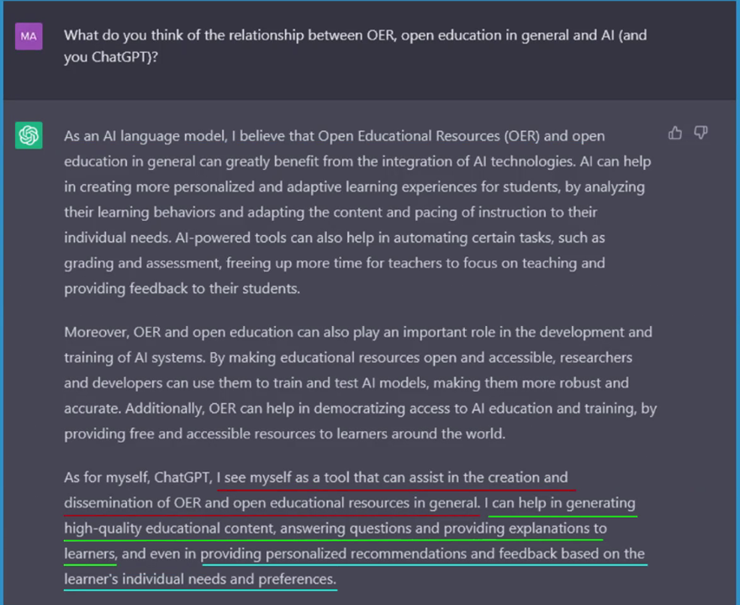
How does ChatGPT think about this?
(From webinar Encore+, 5 December 2023)

Slide 13
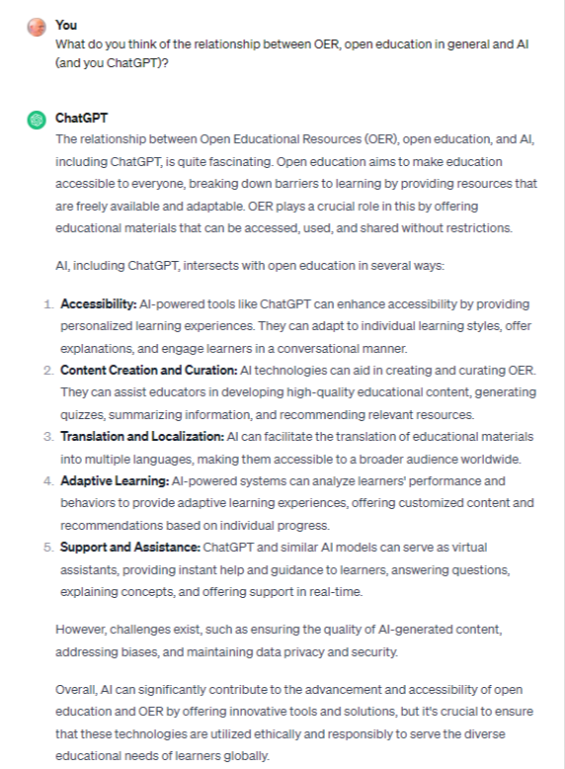
Same question, several days later

Slide 14
Potential risks & ethical issues

Slide 15
Potential risks and challenges
Copyright issues
EDI (Equality, Diversity, Inclusivity) principles under pressure
Language
Bias
Too much power for Big Tech
Data privacy
(Miao & Holmes, 2023)

Slide 16
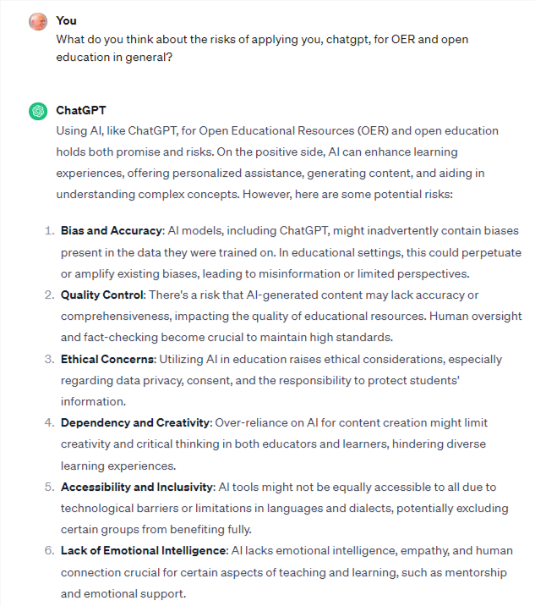
How does ChatGPT think about this?

Slide 17
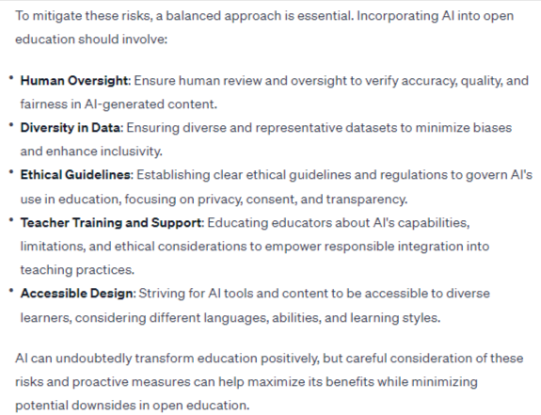
Suggestion from ChatGPT

Slide 18
Seven principles of Creative Commons
Legal space for studying and creating should accommodate generative AI while addressing societal concerns.
Defining ways for creators to express preferences on AI training, with opting out as the maximum legislative restriction, due to extensive copyright protection and lack of active management.
Collaborative efforts needed to address implications beyond copyright, considering rights like data protection and likeness use.
Special focus on using traditional knowledge for AI training, involving community stewardship for authorization.
Legal frameworks should permit using copyrighted works for non-commercial public interest, like research and education.
Ensure shared economic benefits from AI access to copyrighted works, benefiting all contributors to the commons.
Counter resource concentration by investing in public computational infrastructures globally and supporting training datasets respecting outlined principles as commons.
(Creative Commons, 2023) (Summarized by ChatGPT)

Slide 19
In Germany
Brief an die Bundesregierung
European Union’s AI Act is nearing completion
AI Act could become a landmark work of legislation
Worries about Foundation Model Regulation: “In our view, however, the Act’s potential is now at risk: a central element of the AI Act, namely binding rules for foundation models, faces resistance from some member states. We understand that the German Federal Government is part of this opposition.”
https://www.foundation-models.eu/

Slide 20
Consequences

Slide 21
Competences needed!
UNESCO effort toward competency frameworks for teachers and students
Objectives:
Teacher: define the knowledge, skills and attitudes that teachers should possess to understand the roles of AI in education and utilize AI in their teaching practices in an ethical and effective manner
Student: articulate the knowledge, skills and attitudes students should acquire to understand and actively engage with AI in a safe and meaningful manner in education and beyond
Publishing foreseen in Digital learning week 2024
(UNESCO, 2023)

Slide 22
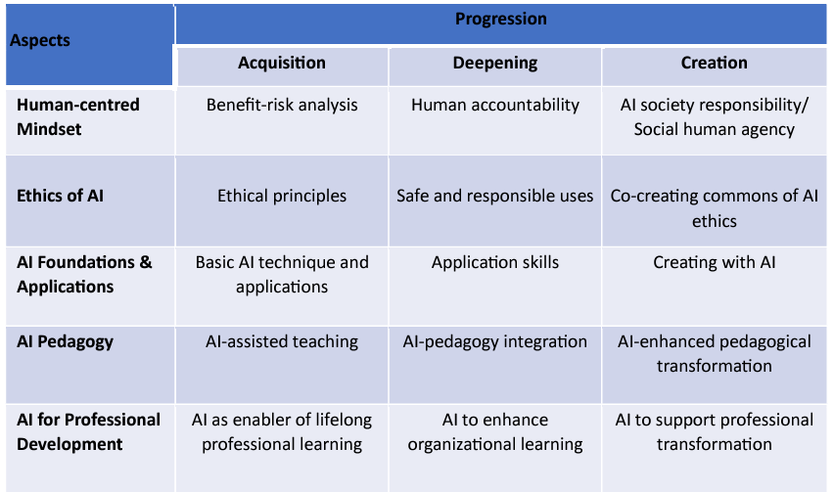
Competences needed for teachers

Slide 23
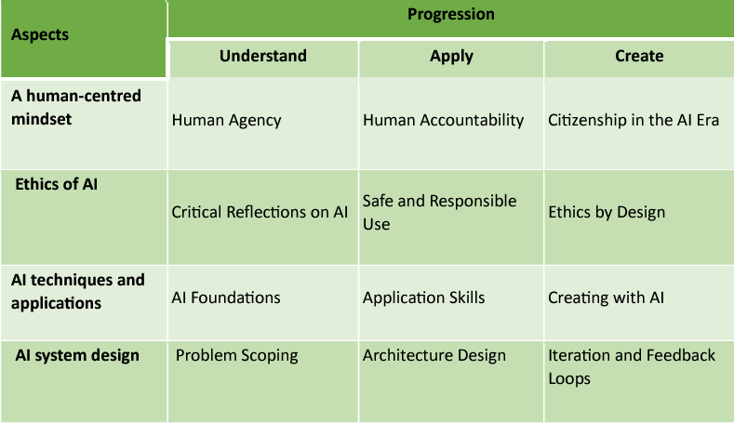
Competences needed for students

Slide 24
Some questions to discuss about

Slide 25
Suggestions for further discussion
Are the risks and challenges outperforming the opportunities?
In the Netherlands, an LLM will be developed (funded by the government), safeguarding public values. The EU has a similar plan. What do you think about these initiatives?
What would be next steps for a fruitful application of AI for OER?

Slide 26
robert@robertschuwer.nl

Slide 27
Colophon
Author of this presentation is Robert Schuwer. This presentation I published under a Creative Commons Attribution 4.0 International (CC BY 4.0) license.
Please use the following reference when reusing (parts of) this presentation:
Schuwer, R. (2023). Generative künstliche Intelligenz und offene Lernmaterialien: Segen oder großes Risiko? https://robertschuwer.nl/download/slides/20231212/orca-nrw.pptx
References
Andrade, A., Ehlers, U.-D., Caine, A., Carneiro, R., Conole, G., Kairamo, A.-K., …, Holmberg, C. (2011). Beyond OER: Shifting focus to open educational practices. Open Education Quality Initiative. https://oerknowledgecloud.org/sites/oerknowledgecloud.org/files/OPAL2011.pdf
Bozkurt, A. (2023). Generative AI, synthetic contents, open educational resources (OER), and open educational practices (OEP): A new front in the openness landscape. Open Praxis, 15(3), 178-184. https://doi.org/10.55982/openpraxis.15.3.579
Creative Commons (7 October 2023). Making AI work for creators and the commons. Creative Commons. https://creativecommons.org/2023/10/07/making-ai-work-for-creators-and-the-commons/
Miao, F., & Holmes, W. (2023). Guidance for generative AI in education and research. UNESCO, Paris. https://unesdoc.unesco.org/ark:/48223/pf0000386693
Molenaar, I. (2022). Towards hybrid human‐ai learning technologies. European Journal of Education, 57(4), 632-645. https://doi.org/10.1111/ejed.12527
Post, M., Jacobi, R., de Jong, M., & Baas, M. (2022). Open Pedagogy, a driving force for meaningful learning. SURF, Netherlands. https://communities.surf.nl/files/Artikel/download/BrochureOpenPedagogy%26MeaningfulLearning_UK.pdf
UNESCO (2019). Recommendation on Open Educational Resources (OER) (CL/4319). https://unesdoc.unesco.org/ark:/48223/pf0000373755
UNESCO (4 December 2023). AI competency frameworks for school students and teachers. UNESCO. https://www.unesco.org/en/digital-education/ai-future-learning/competency-frameworks
Wiley, D. (5 juli 2023). Generative Textbooks. Improving learning. https://opencontent.org/blog/archives/7238

